Slide 1
50.003: Elements of Software Construction
Week 11
Pitfalls and Testing and Parallelization

Slide 2
Plan of the Week
Applying Executor
Patterns for parallelization
Pitfalls: synchronization challenges
Avoiding and diagnosing deadlocks
Avoiding and diagnosing liveness hazards
Testing concurrent programs
Testing for correctness
Testing for performance

Slide 3
Applying executor

Slide 4
Finding Exploitable Parallelism
The executor framework makes it easy to submit and execution tasks as well as specify an execution policy.
How do you define the tasks such that you can get the maximum performance?

Slide 5
Example 1
How do web servers process HTML requests?
rendering the texts, leaving placeholders for the images, and load images later
public class SingleThreadRender {
void renderPage (CharSequence source) {
renderText(source);
List<ImageData> imageData = new ArrayList<ImageData>();
for (ImageInfo imageInfo: scanForImageInfo(source))
imageData.add(imageInfo.downloadImage());
for (ImageData data: imageData)
renderImage(data);
}
}

Slide 6
Example 1 (cont’d)
Using Future to download while rendering text concurrently
Place time limits on tasks
Use Future.get(long timeout, TimeUnit unit) to time out
Click here for a sample program:
FutureRenderer.java

Slide 7
Example 2: Parallelizing Loops
Loops are suitable for parallelization when each iteration is independent and the work in each iteration is significant enough.
void processSequentially(List<Element> elements) {
for (Element e : elements) {
process(e);
}
}
void processInParallel(Executor exec, List<Element> elements) {
for (final Element e : elements) {
exec.execute(new Runnable() {
public void run() { process(e); }
});
}
}

Slide 8
Parallelizing Recursive Algorithms
Loop parallelization can also be applied to some recursive designs.
Click here for a sample program:
ParallelRecursive.java

Slide 9
Cohort Exercise 1
Recall GDesktop.java from Week 9, improve the program by parallelizing the crawl method with the help of a thread pool.
Click here for a sample program:
GDesktopWithThreadPool.java

Slide 10
Pitfalls: Deadlock and More

Slide 11
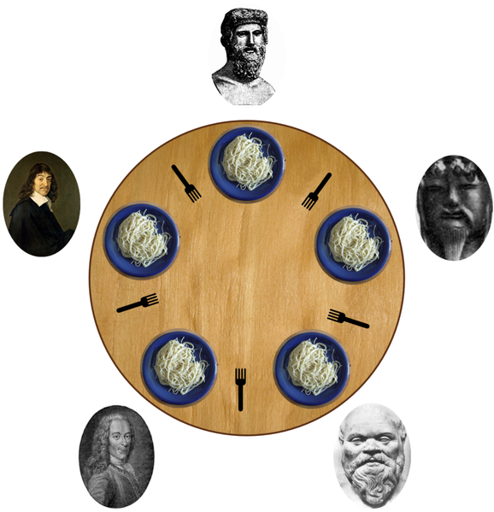
Example: Dining Philosophers
0
Each philosopher needs two forks to eat.
Each philosopher picks the one on the left first.
4
0
4
1
3
1
2
2
3

Slide 12
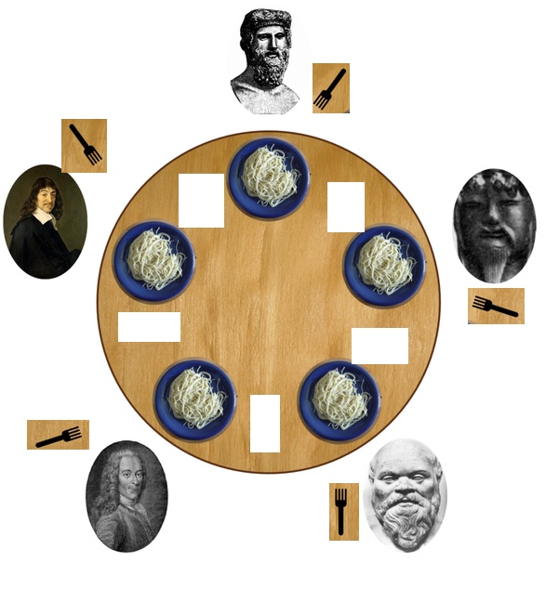
Deadlock
Deadlock is the situation when two or more threads are both waiting for the others to complete, forever.

Slide 13
Cohort Exercise 2 (10 min)
Given DiningPhil.java, modify it so as to demonstrate the deadlock.
Sample Solution: DiningPhilDemo.java

Slide 14
Lock-Ordering Deadlock
public class LeftRightDeadlock {
private final Object left = new Object ();
private final Object right = new Object ();
public void leftRight () {
synchronized (left) {
synchronized (right) {
doSomething();
}
}
}
public void rightLeft () {
synchronized (right) {
synchronized (left) {
doSomethingElse();
}
}
}
}
Thread A
Thread B
lock left
lock right
try to lock right
wait for lock left
wait forever
wait forever

Slide 15
Example
public void transferMoney (Account from, Account to, int amount) {
synchronized (from) {
synchronized (to) {
if (from.getBalance() < amount) {
//raiseException
}
else {
from.debit(amount);
to.credit(amount)
}
}
}
}
Is it deadlocking?

Slide 16
Example
public void transferMoney (Account from, Account to, int amount) {
synchronized (from) {
synchronized (to) {
if (from.getBalance() < amount) {
//raiseException
}
else {
from.debit(amount);
to.credit(amount)
}
}
}
}
How can transferMoney deadlock?
Thread A: transferMoney(myAccount, yourAccount, 1)
Thread B: transferMoney(yourAccount, myAccount, 1)
Check out: DemonstrateDeadlock.java

Slide 17
Cohort Exercise 3 (15 min)
Given DLExample.java, explain whether it is possibly deadlocking.

Slide 18
Avoid Deadlock: Heuristics
A program that never acquires more than one lock at a time cannot experience lock-ordering deadlocks.
A program will be free of lock-ordering deadlocks if all threads acquire the locks they need in a fixed global order.
Is this deadlocking? Thread A locks a, b, c, d, e in the sequence and thread B locks c, f, e.
Is this deadlocking? Thread A locks a, b, c, d, e in the sequence and thread B locks e, f, c.

Slide 19
Example
public void transferMoney (Account from, Account to, int amount) {
synchronized (from) {
synchronized (to) {
if (from.getBalance() < amount) {
//raiseException
}
else {
from.debit(amount);
to.credit(amount)
}
}
}
}
Click here for a sample program: TransferFixed.java

Slide 20
Avoid Deadlocks
Strive to use open calls (calling a method with no locks held) throughout your program
Click here for a sample program: DLExampleFixed.java

Slide 21
Avoid Deadlocks
Use the timed tryLock feature of the explicit Lock class instead of intrinsic locking.
Lock lock = new ReentrantLock();
if (lock.tryLock()) {
try { // Process record }
finally { // Make sure to unlock
lock.unlock();
}
}
else {
// Someone else had the lock, abort
}

Slide 22
Cohort Exercise 4 (15 min)
Fix DiningPhil.java by making it deadlock-free, in two different ways.

Slide 23
Other Liveness Hazards
Deadlock is the most widely encountered liveness hazard.
Starvation occurs when a thread is denied access to resources it needs in order to make progress.
Often caused by use of thread priority or executing infinite loops with a lock held.
Avoid using thread priority, since they increase platform
dependence and can cause liveness problems.

Slide 24
Other Liveness Hazards (cont’d)
Poor responsiveness
may be caused by poor lock management.
Livelock: a thread, while not blocked, still cannot make progress because it keeps retrying an operation that will always fail.
e.g., when two overly polite people are walking in the opposite direction in a hallway.

Slide 25
Program Testing

Slide 26
Testing
For sequential programs,
Finding the right inputs
For concurrent programs,
Finding the right inputs and scheduling
Bugs that disappear when you add debugging or test code are called Heisenbugs.

Slide 27
Testing
Testing for correctness
Safety: nothing bad ever happens
Liveness: something good eventually happens
Testing for performance
Throughput: the rate at which a set of concurrent tasks is completed
Responsiveness: the delay between a request and completion of some action

Slide 28
Step 1: Identifying Specification
You must know what is correct.
Identify
class invariants which specify relationships among the variables;
pre/post-conditions for each method;
whether the class is thread-safe and how its states guarded
Click here for a sample program: BoundedBufferWithSpec.java

Slide 29
Step 2: Basic Unit Tests
Create an object of the class, call its methods (in different sequences with different inputs) and assert post-conditions and invariants.

Slide 30
jUnit Test Cases
At the top of the file, include:
import junit.framework.TestCase;
The main class of the file must:
be public and extend TestCase
Methods of this class to be run automatically when the Test command
is invoked must:
be public and not static; return void; take no arguments; have a
name beginning with "test"
Click here for a sample program: BoundedBufferTest.java
testIsEmptyWhenConstructued()
testIsFullAfterPuts()

Slide 31
Cohort Exercise 5 (10 min)
Given BoundedBufferTest.java,
write two more test cases
document what you are testing for.

Slide 32
Testing Blocking Operations
How do we test that an operation has been blocked (in a concurrent context)?
Click here for a sample program: BoundedBufferTest.java

Slide 33
Step 3: Test for Concurrency
Set up multiple threads performing operations over some amount of time and then somehow test that nothing went wrong
Mind that the test programs are concurrent programs too!
It’s best if checking the test property does not require any synchronization

Slide 34
Example
Question: how do we test that everything put into the buffer comes out of it and that nothing else does, assuming there are multiple producers and consumers?
A naïve approach: maintain a “shadow” list and assert that the buffer is consistent with the “shadow” list
Use a check sum function would be better (see example later)

Slide 35
Example
Some test data should be generated randomly
Random number generator can create couplings between classes and timing artifacts because most random number generator classes are thread-safe and therefore introduce additional synchronization.
Use pseudo-random number generator
static int xorShift (int y) {
y ^= (y << 6);
y ^= (y >>> 21);
y ^= (y << 7);
return y;
}

Slide 36
Example
Click here for a sample program: PutTakeTest.java

Slide 37
Cohort Exercise 6 (15 min)
Testing for Resource Management
How to test that a thread pool indeed created a given number of threads which is less than or equal to the maximum thread pool size?
Complete TestThreadPoolSample.java
Sample Solution: TestThreadPool.java

Slide 38
Generating More Scheduling
Test with more active threads than CPUs
Testing with different processor counts, operating systems, and processor architectures
Encourage context switching using Thread.yield() or Thread.sleep(10)
Public synchronized void transfer (Account from, Account to, int amount) {
from.debit(amount);
if (random.nextInt(1000) > THREADHOLD) {
Thread.yield();
}
to.credit(amount);
}

Slide 39
Step 4: Testing for Performance
Identify appropriate test scenarios – how the class is used
Sizing empirically for various bounds, e.g., number of threads, buffer capabilities, etc.
Click here for a sample program: TimedPutTakeTest.java

Slide 40
Cohort Exercise 7 (10 min)
Design and implement a test program to compare the performance of
BoundedBuffer
ArrayBlockingQueue
LinkedBlockingQueue
Click here for a sample program:
TimedPutTakeTest.java
TimedPutTakeTestABQ.java
TimedPutTakeTestLBQ.java

Slide 41
Besides Testing
Code review
Static analysis tools
Model checkers
Profilers and monitoring tools
Testing can only review the presence of bugs, not their absence;
In complex programs, no amount of testing can find all coding errors;

